Slide 1

Presented by: NAREN & SAHIL (GROUP 3)

Slide 2
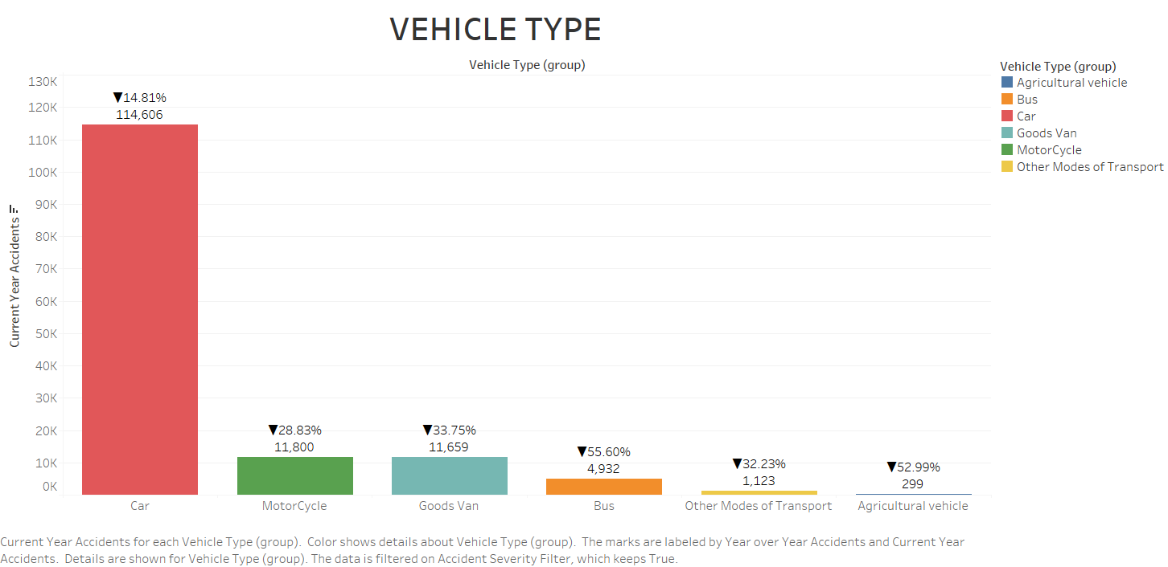
Kaggle – UK Road Safety: Traffic Accidents and Vehicles (kaggle.com)

Slide 3
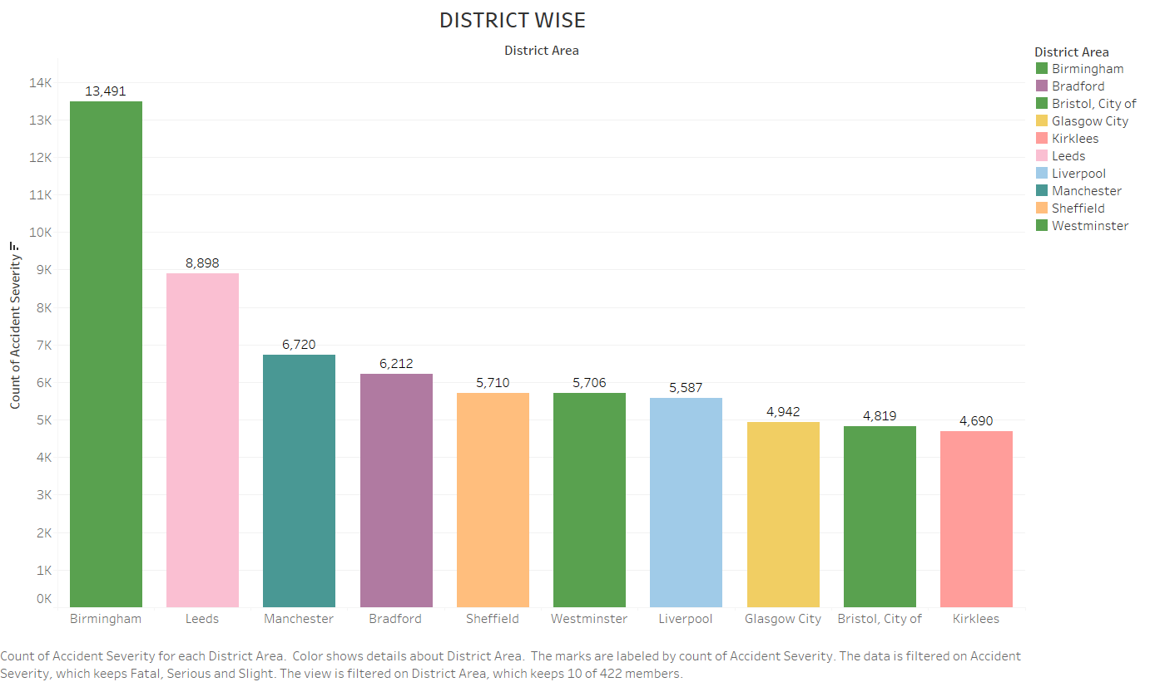

Slide 4
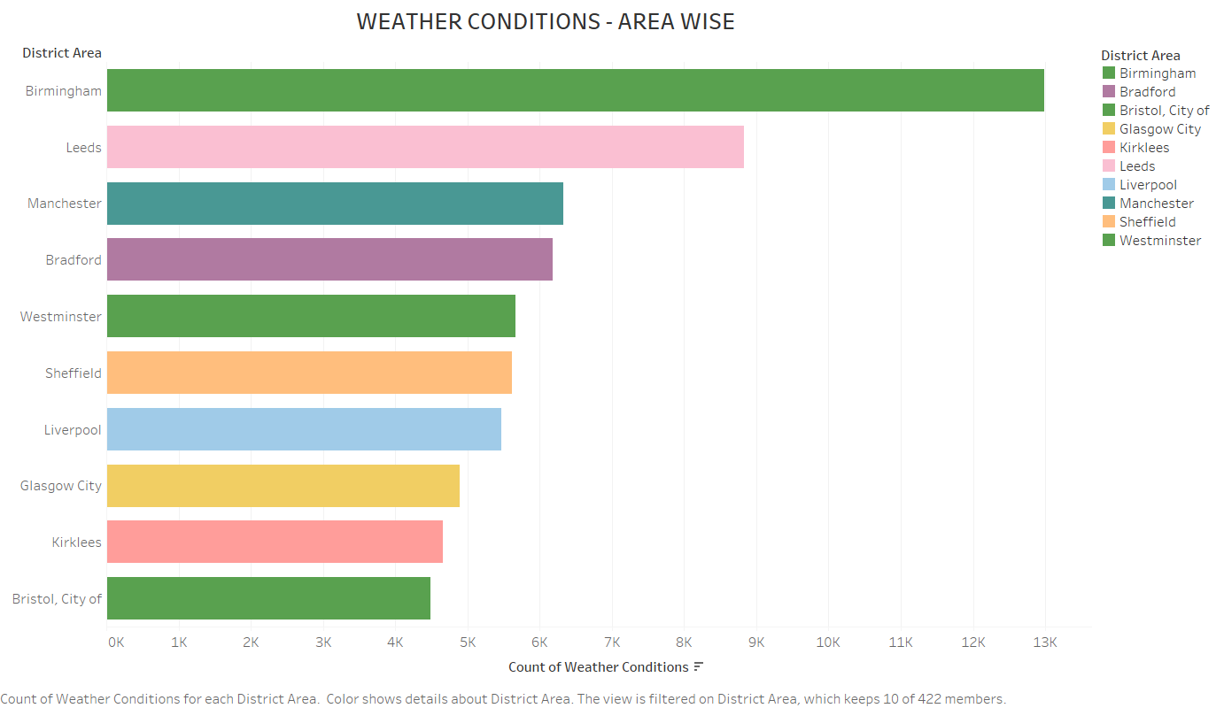

Slide 5
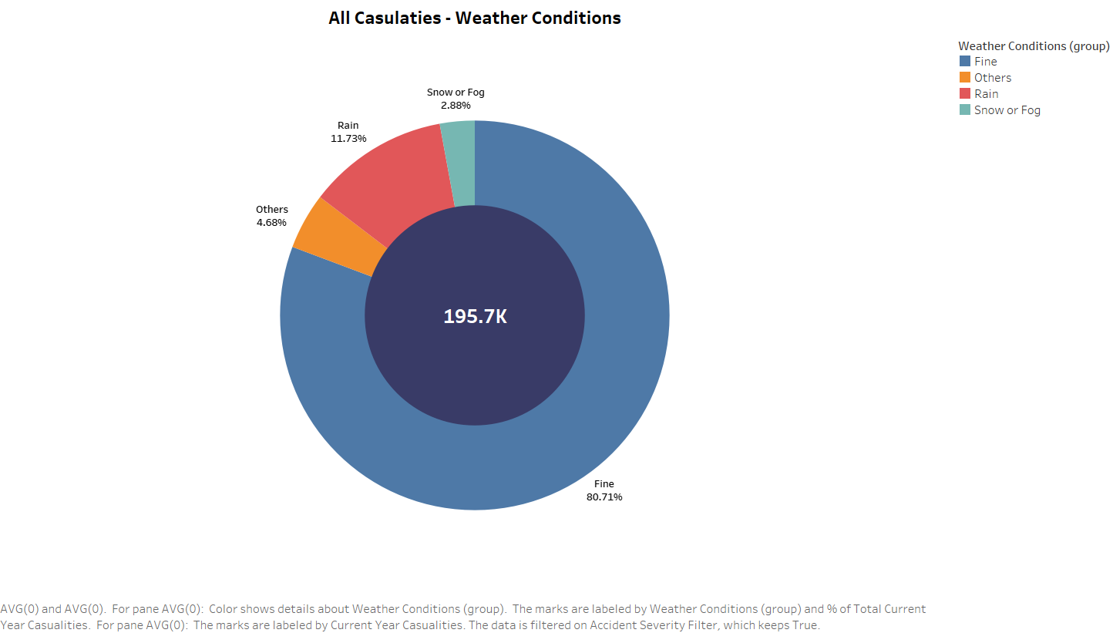

Slide 6
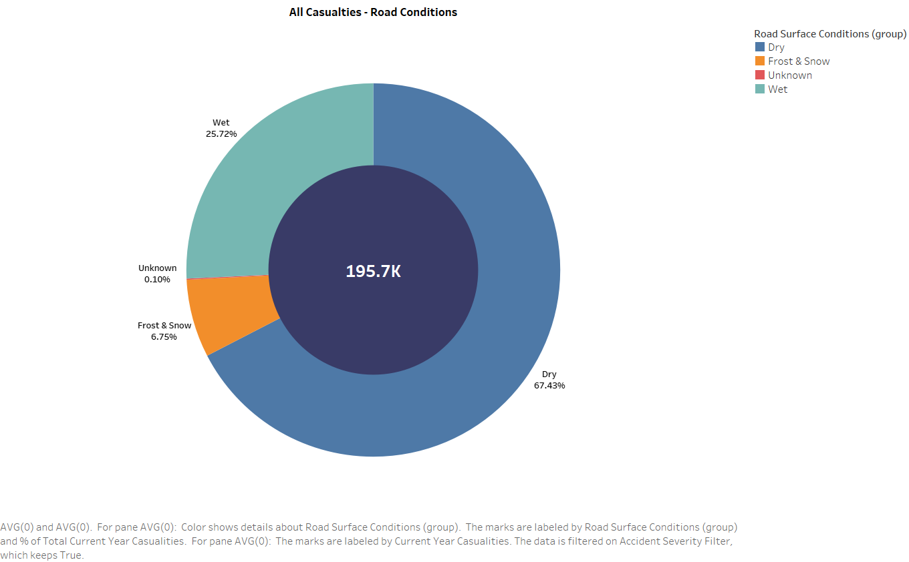

Slide 7
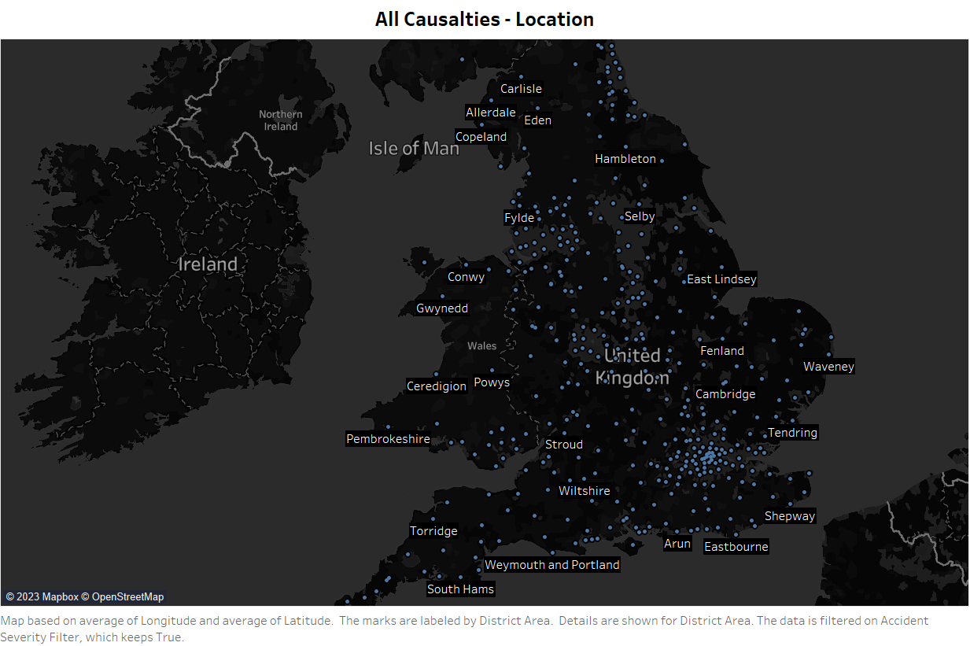

Slide 8
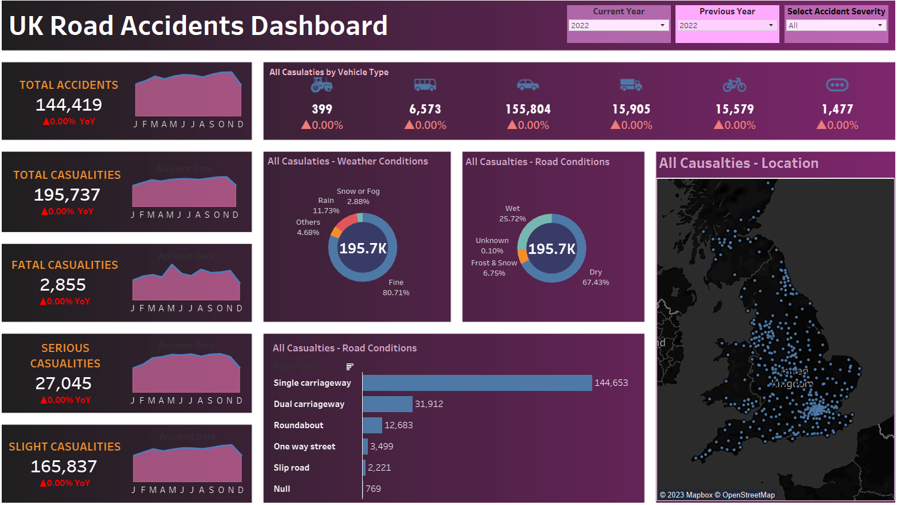
Dashboard

Slide 9
QUESTIONS?

